Slide 1
Multimedia Computing
By
Minhaz Uddin Ahmed, PhD
Department of Computer Engineering
Inha University in Tashkent.
Email: minhaz.ahmed@gmail.com

Slide 2
Content
Picture element
Basic relationship among pixels
Neighbors of a pixel
Connectivity
Adjacent pixel
Arithmetic operation
Color representation
CIE XYZ to RGB

Slide 3
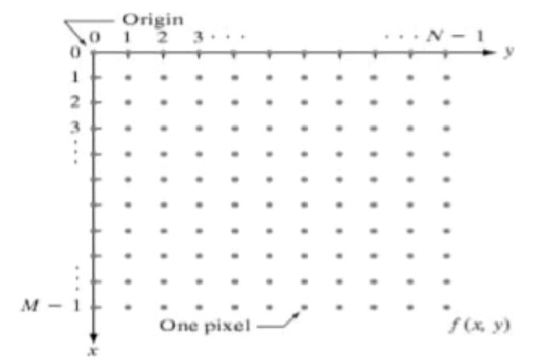
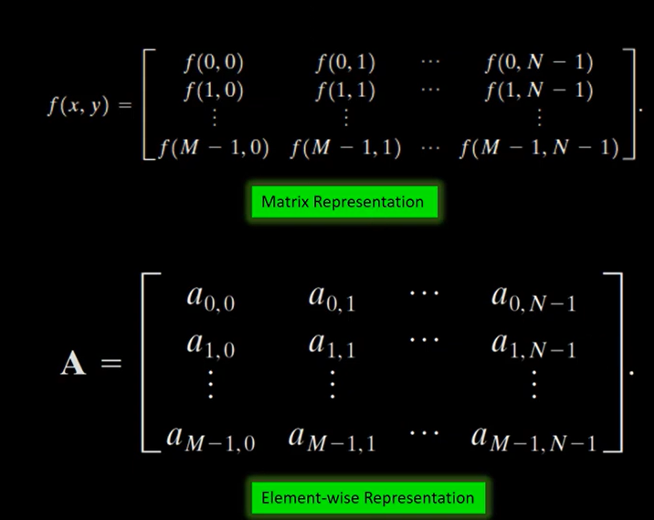
Coordinate Convention
Coordinate convention to represent digital image
An image's element-wise representation treats each pixel independently as an individual data point, whereas its matrix representation structures the entire grid of pixels as a unified mathematical object for spatial transformations

Slide 4
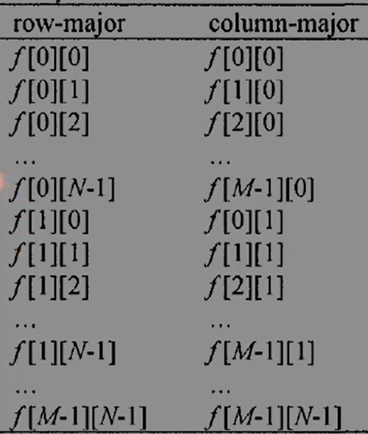
Matrix Flattening
For performance reasons we usually do not store image in the matrix fashion when coding image processing algorithms in Embedded Systems.
There are two prevalent ordering schemes for storing flattened 2D matrices:
Row-major
Column-major

Slide 5

Radiometry
In radiometry light is considered to be a traveling form of energy and therefore the unit used to describe, the unit of energy, joule (J). This energy is associated with a source of origin, which is usually defined by its position, a direction of propagation and a wavelength λ. The particle theory of light where the smallest unit of light is considered to be a photon or a quantum of energy. This also conforms to the wave theory of light, which assumes light to be a waveform traveling in a particular direction. λ is expressed by units of nanometers (nm). Light travels with a speed c (vacum) n in a medium of refractive index n. An invariant in this context is the frequency f of light is given by

Slide 6

Radiometry
which does not change unlike Cn and λ. Another invariant is the energy carried by a photon
The spectral energy is a density function that gives the density of the quantum energy at an infinitesimal interval of wavelengths around λ with a width of ∆λ.
Radiometry is the science and technology of the measurement of radiation from all wavelengths within the optical spectrum. The basic unit of power in radiometry is the watt (W).

Slide 7
Photometry
Study of measurement of light in terms of visual response it produces
Study concerned with the ways of measuring intensity of light
Branch of Radiometry
The difference between radiometry and photometry is that radiometry includes the entire optical radiation spectrum (and often involves spectrally resolved measurements), while photometry deals with the visible spectrum weighted by the response of the eye.

Slide 8
Visual sensitivity
Sensitivity of an individual to particular wavelength at a given viewing condition
Different for different individuals
Variation can be achieved from the sensitivity /luminosity curve

Slide 9
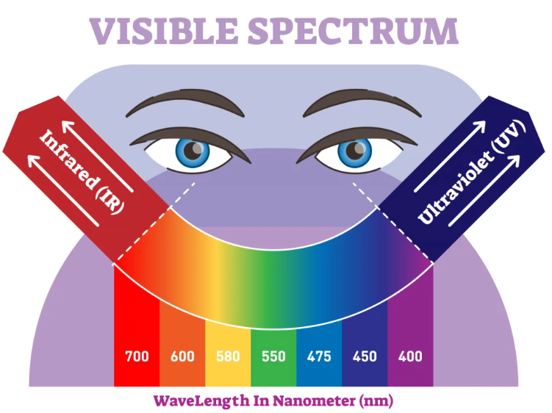
Scotopic and photopic vision
Photopic vision
Maximum visual effect at 555 nm(yellow -green)
At 510nm and 610 nm the sensitivity reduces to half
Scotopic Vision
Maximum effect at 507nm (blue-green)
Lower intensities are needed

Slide 10
Photometry and Color
Photometric quantities have an aspect of perception associated with them. Color is a photometric quantity that we use all the time. A person, who lost color perception due to an accident exclaimed with anguish, My dog looks gray, tomato juice is black and color TV is an hodge podge". Color not only adds beauty to our life, but serves important signaling functions. The natural world provide us with many signals to identify and classify objects. Many of these come in terms of color. For e.g. banana turns yellow when its ripe, the sky turns red when it is dawn and so on.

Slide 11
Basic information on Light
The color of an object are determined by the nature of the light reflected
A body that reflects light relatively balanced in all visible wavelengths appears white to the observer
Whichever favors reflectance in a limited range of the visible spectrum exhibits some shades of color (chromatic light)

Slide 12
Achromatic light
Light that is void of color is called monochromatic (achromatic) light.
The only attribute of monochromatic light is its intensity or amount.
Achromatic images known as gray scale image.

Slide 13
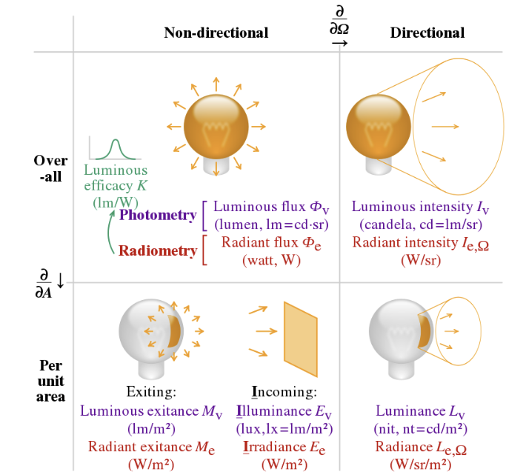
Radiance
Radiance is the total amount of energy that flows from the light source , and it is usually measured in watts(W).

Slide 14
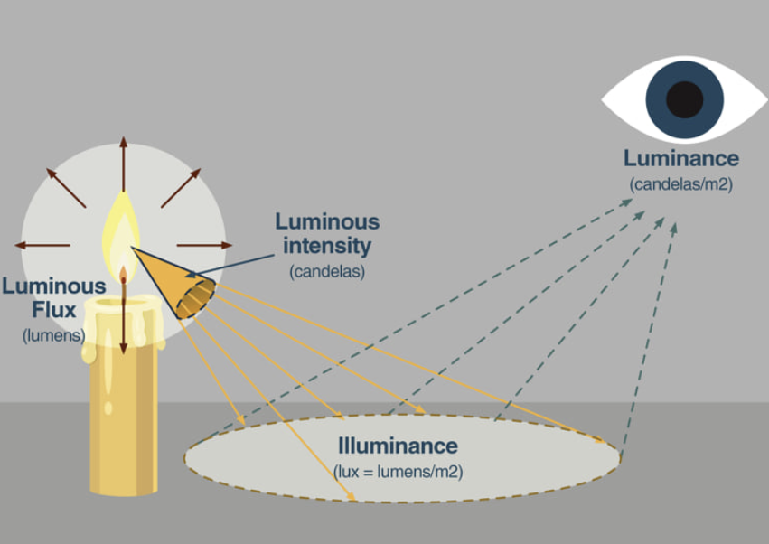
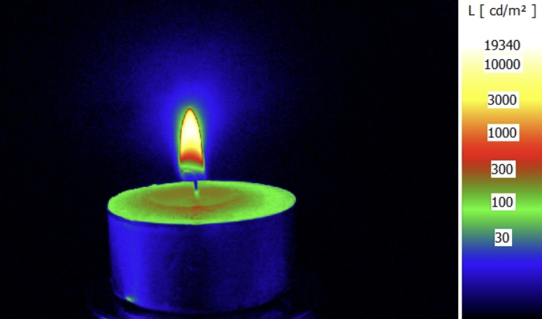
Luminance
Luminance, measured in lumens (lm), gives a measure of the amount of energy an observer perceives from a light source.

Slide 15
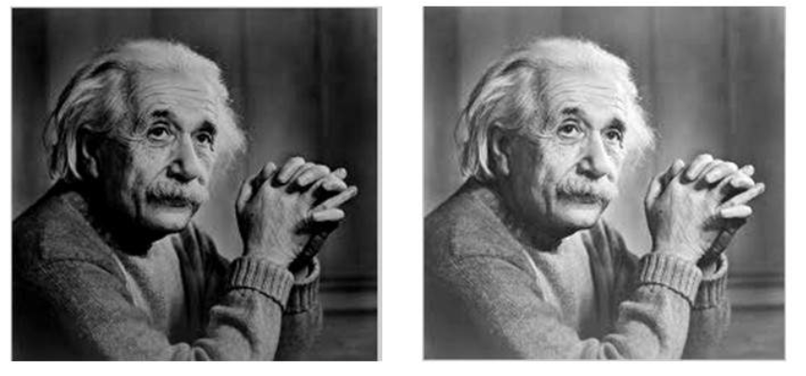
Brightness
Brightness is a subjective descriptor of light perception that is practically impossible to measure.

Slide 16
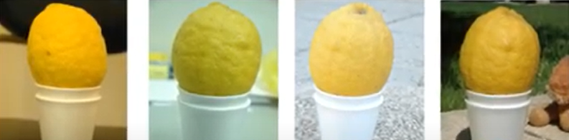
Energy Source of Image
The principal energy source for images in use today is the electromagnetic (EM) energy spectrum.
Synthetic images, used for modeling and visualization are generated by computer.
Notes:
Color constancy

Slide 17
Two Major Tasks
Improvement of pictorial information for human interpretation
Processing of image data for storage, transmission and representation for autonomous machine perception.

Slide 18

Image formation model
Image refers to a 2D light-intensity function, f(x,y)
Amplitude of f at spatial coordinates (x,y) gives the intensity (brightness) of the image at that point.
Light is a form of energy thus f(x,y) must be nonzero and finite.
0<f(x,y) <

Slide 19
Illumination and Reflectance
The basic nature of f(x,y) may be characterized by 2 components:
Illumination, i(x,y) : the amount of source light incident on the scene being viewed.
Reflectance, r(x,y): the amount of light reflected by the objects in the scene.

Slide 20

Resolution
Resolution (how much you can see the detail of the image) depends on sampling and gray levels.
The bigger the sampling rate (MxN) and the gray scale level (K), the better the approximation of the digitized image from the original. But the size of the image gets bigger
B=M x N x K
Due to storage and quantizing hardware consideration, the number of intensity level (L) typically is an integer power of 2.

Slide 21
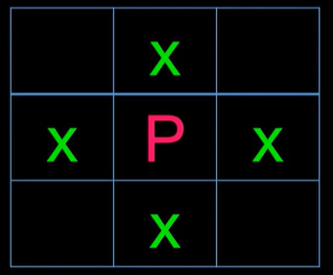
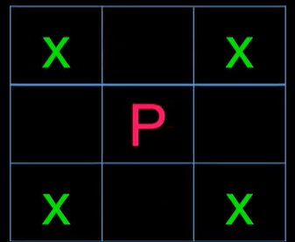
Neighbor of a pixel
A pixel P has at coordinates (x,y) has
N4(p): four neighbors of p
ND(P): four diagonal neighbor of P
N8(p): Eight neighbors of P

Slide 22
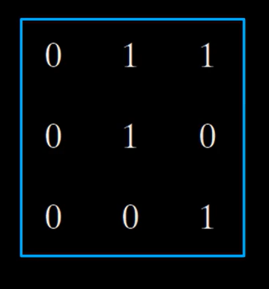
Connectivity
Let V be the set of gray-level values used to defined connectivity
4-connectivity:
2 pixels p and q with values from V are 4-connected if q is in the set N4(p)
8-connectivity:
2 pixels p and q with values from V are 8-connected if q is in the set N4(p)

Slide 23
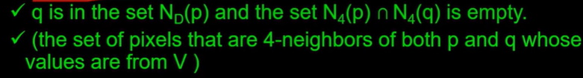
Connectivity
Let V be the set of gray-level values used to define connectivity.
M-connectivity(mixed connectivity)
2 pixels p and q with values from V are m connectivity if
q is the set N4(P) or

Slide 24
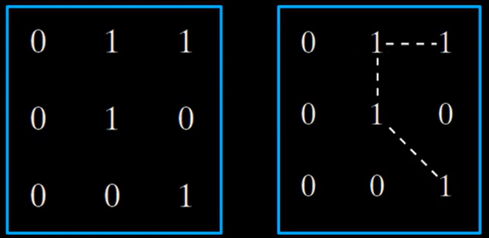
M-Connectivity
m-connectivity eliminates the multiple path connections that arises in 8-connectivity.

Slide 25
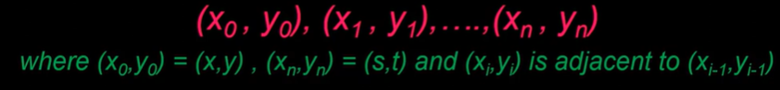
Path
A (digital) path from pixel P with coordinates (x,y) to pixel q with co-ordinates (S,t) is a sequence of distinct pixels with coordinates
n is the length of the path

Slide 26
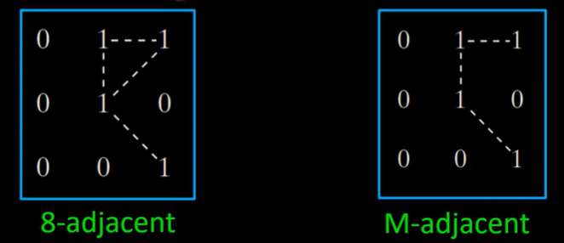
Adjacent
A pixel p is adjacent to a pixel q if they are connected.

Slide 27
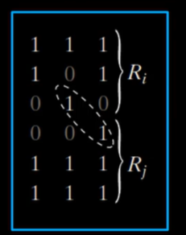
Adjacent
Two image area subsets R1 and R2 are adjacent if some pixels in R1 is adjacent to some pixels R2

Slide 28
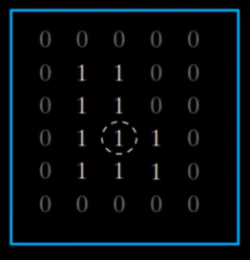
Adjacent
The circle point is part of the boundary of the 1 valued pixels only if 8-adjacency between the region and background is used.

Slide 29
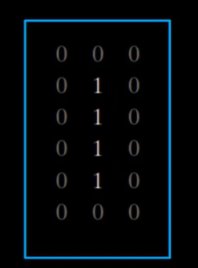
Adjacent
The inner boundary of the 1-valued region does not form a closed path, but its outer boundary does.

Slide 30
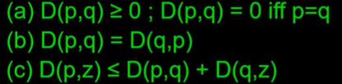
Distance measures
For pixel p,q, z with coordinates (x,y),(s,t) and (u,v) respectively,
D is the distance function or metric if

Slide 31
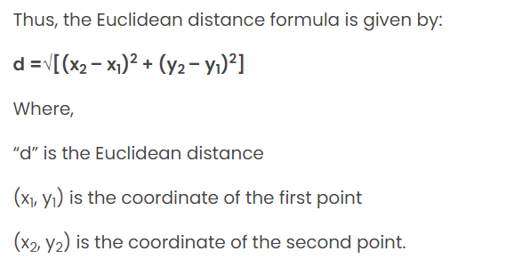
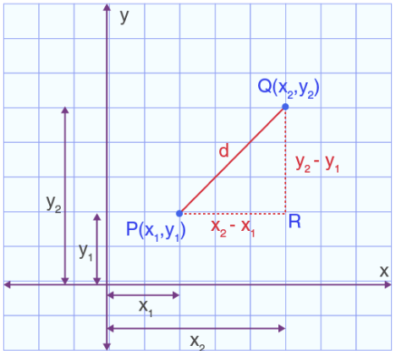

Euclidean Distance
The Euclidean distance is defined as the distance between two points. In other words, the Euclidean distance between two points in the Euclidean space is defined as the length of the line segment between two points.
Standard equation
Notes:
P(x,y)= (0,0) and q (s,t) = (4,4) =5.65 units

Slide 32
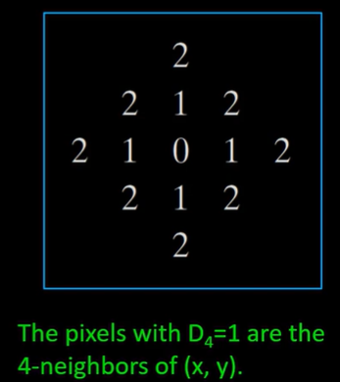

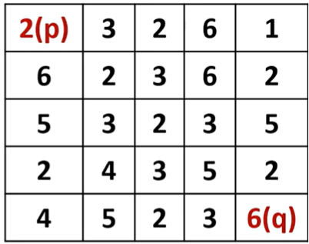
City block distance
The D4 distance (also called city-block distance) between P and q is defined as
In this case, the pixel having a distance from (x,y) less than or equal to some value r from a diamond centered at (x,y)
Notes:
Cardinality of x-s + cardinality of y-t. D4(p,q)= |4-0|+|4-0| , D4(p,q)=8 units

Slide 33
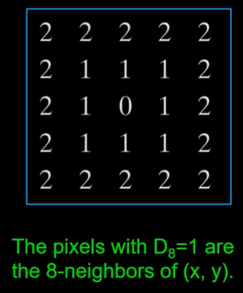

Chessboard Distance
The D8 distance (also called chessboard distance) between p and q is defined as
In this case, the pixels with D8 distance from (x,y) less than or equal to some value r from a square centered at (x,y).
Notes:
D8(p,q) = max (|4-0|, |4-0|) =max(4,4) =4 units

Slide 34
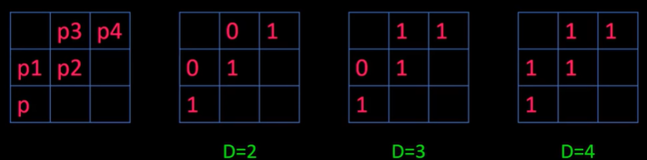
M-connectivity distance
Distance of m-connectivity of the path between 2 pixels depends on values of the pixels along the path.
E.g. if only connectivity of pixel values 1 is allowed. Find the m-distance between p and p4

Slide 35
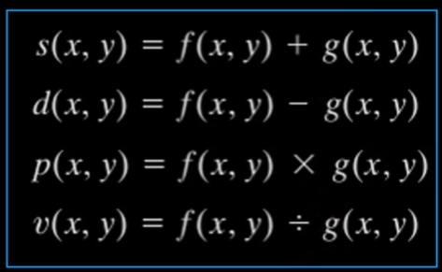
Arithmetic operation
Image arithmetic involves images are same size

Slide 36
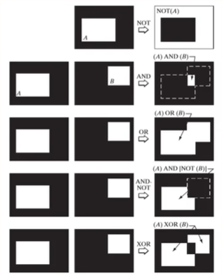
Logical operations
Illustrations of logical operations involving foreground white pixels
Black represent binary 0 and white represent binary 1

Slide 37
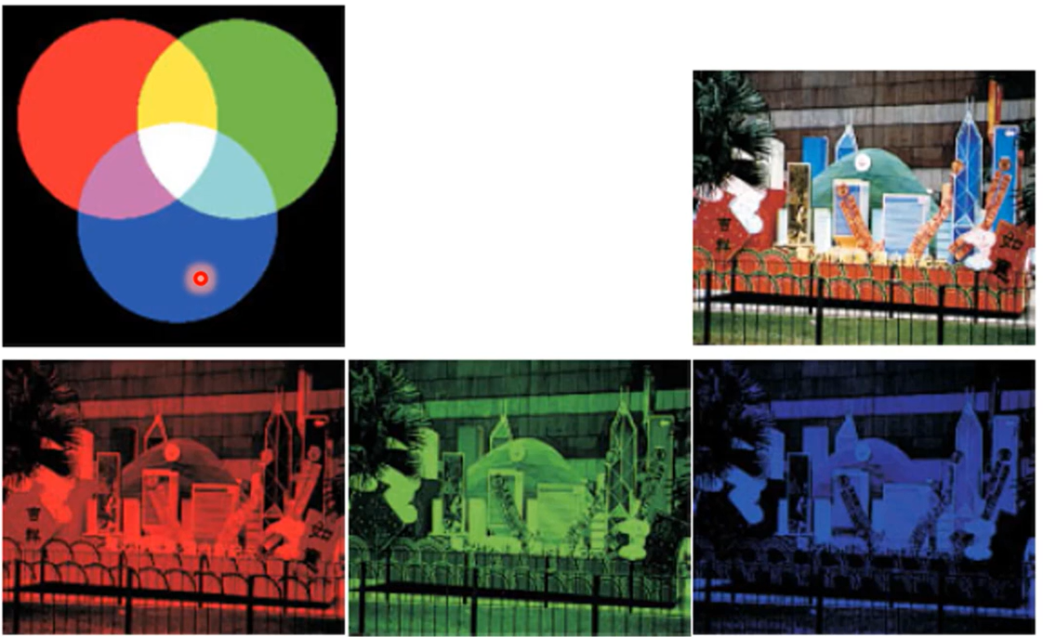
Color Image
Separate channel for different color
RGB
Some model separates color information from Brightness intensity
HSI
Notes:
Hue , Saturation, Intensity

Slide 38
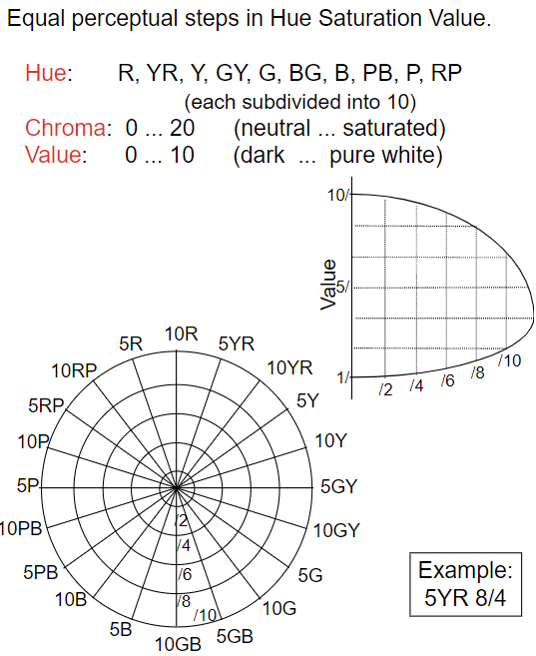
Munsell Color System (1915)

Slide 39
Three dimensions of color
Our perception of color can be described through 3 qualities:
HUE
Value
Intensity /Saturation
What color? Lightness or darkness value? level
Notes:
HUE a gradation or variety of a color; the property of light by which the color of an object is classified as red, blue, green, or yellow in reference to the spectrum.
VALUE refers to the lightness or darkness of a hue. Every hue can range in value from light to dark
Its brightness or dullness (its intensity)

Slide 40
Three dimensions of color
A color sphere or color solid :
Is the three dimensional representation of a color system where it depicts an added dimension of color variation. A 2D color wheel typically depicts the variables of hue and brightness, a color solid adds the variable of saturation, depicting all conceivable colors in an organized three dimensional structure.

Slide 41
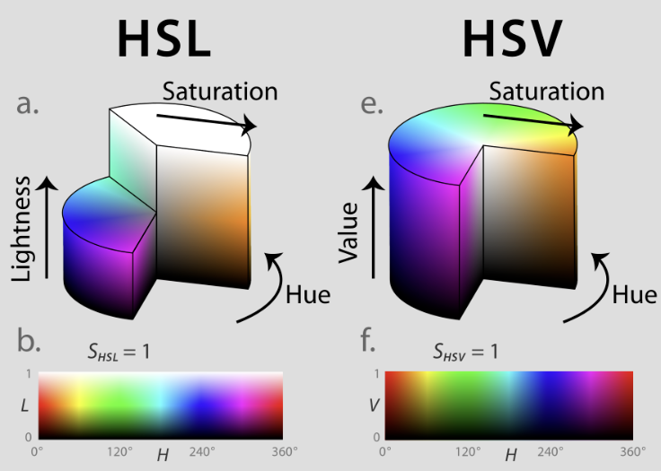
Color representation
CIE XYZ Color space
CIE Chromaticity space
HSL, HSV, LUV, CIE Lab
International Commission on Illumination (CIE)
Chromaticity is an objective specification of the quality of a color regardless of its luminance. Chromaticity consists of two independent parameters as hue (h) and colorfulness (s), where the latter is alternatively called saturation, chroma, intensity, or excitation purity
HSL (for hue, saturation, lightness)
HSV (for hue, saturation, value
Lab It expresses color as three values: L* for perceptual lightness and a* and b* for the four unique colors of human vision: red, green, blue and yellow.

Slide 42
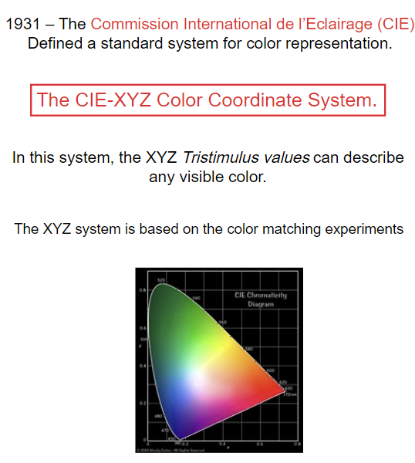
CIE XYZ Color Coordinate system

Slide 43
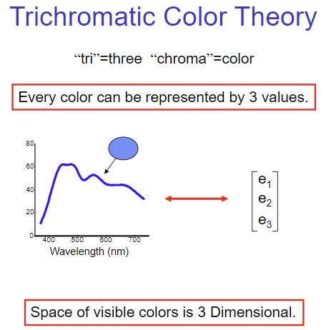
CIE XYZ Color Coordinate system

Slide 44
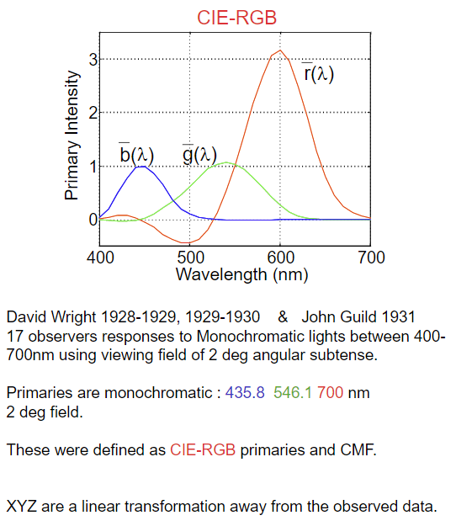
Calculate CIE XYZ Color Coordinate system

Slide 45
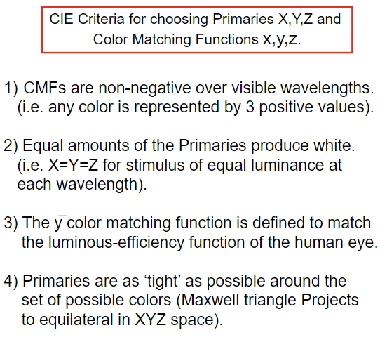
Calculate CIE XYZ Color Coordinate system

Slide 46
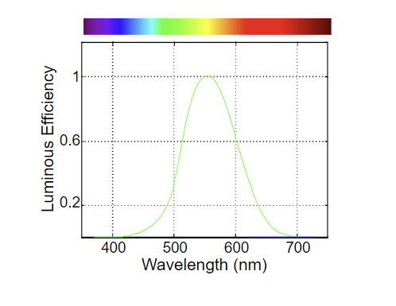
Luminous-Efficiency function of the human eye
Color blindness changes the sensitivity of the eye as a function of wavelength. For people with protanopia, the peak of the eye's response is shifted toward the short-wave part of the spectrum (approximately 540 nm), while for people suffering deuteranopia, there is a slight shift in the peak of the spectrum, to about 560 nm. People with protanopia have essentially no sensitivity to light of wavelengths more than 670 nm.

Slide 47
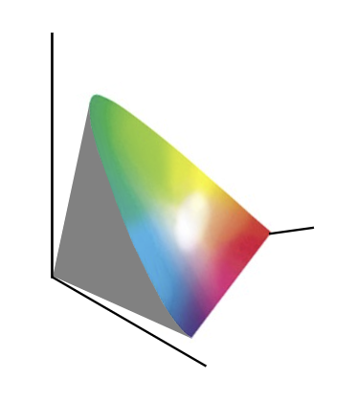
CIE XYZ Color coordinate system
Y (Luminance): Measures perceived brightness or lightness. It matches the human eye's varying sensitivity to different green and yellow wavelengths.
X (Red mix): A mix of response curves chosen mathematically to cover longer and shorter wavelengths while keeping values positive.
Z (Blue response): Corresponds roughly to shorter-wavelength (blue) light stimulation

Slide 48
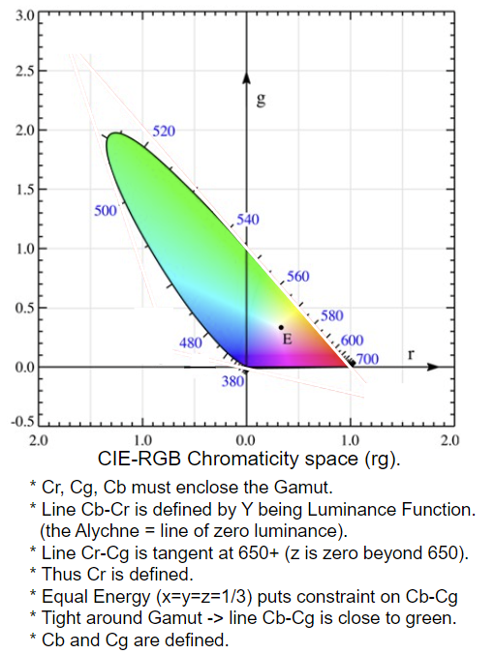
CIE-RGB to CIE-XYZ

Slide 49
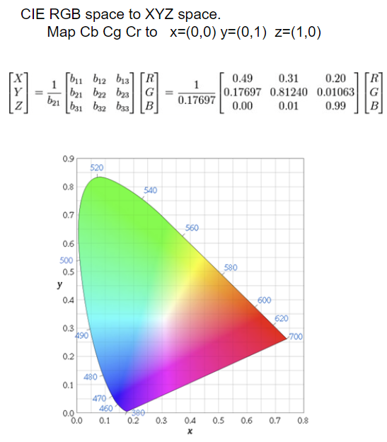
CIE-RGB to CIE-XYZ

Slide 50
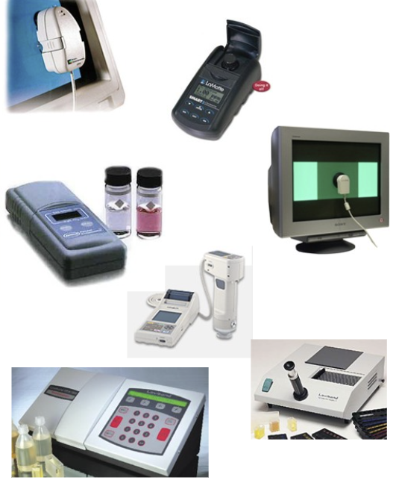
Colorimeters
A colorimeter is a light-sensing device that is used to measure the absorbance and transmittance of light as it moves through a sample of liquid. The main components of a colorimeter include: Illuminant: A specific, fixed light source that passes through the object.
analysis of blood, water, soil nutrients and foodstuffs, determination of solution concentration, determination of reaction levels, and determination of bacterial crop growth

Slide 51
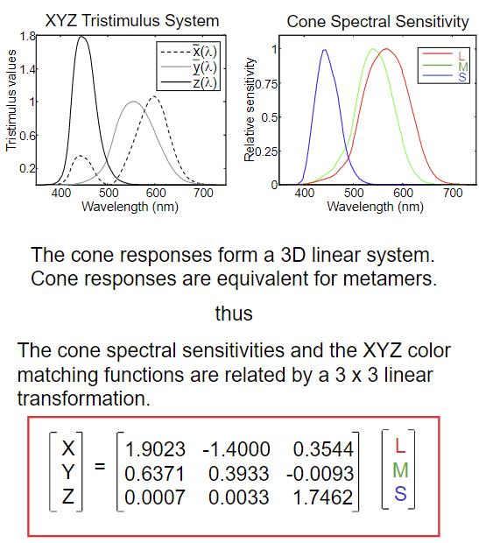
Color matching function vs LMS(long medium short) –cone photoreceptor responses

Slide 52
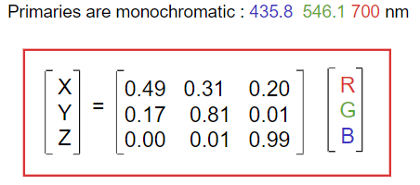
CIE -RGB

Slide 53
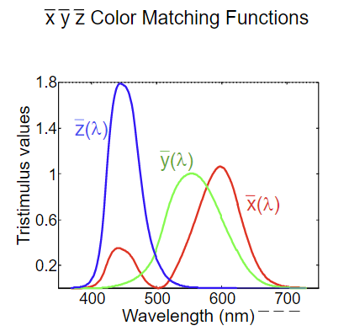
CIEXYZ Color Coordinate System

Slide 54
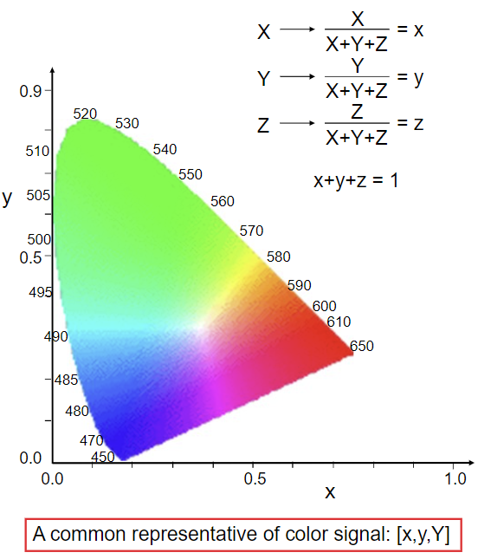
CIE Chromaticity Diagram
A common representation of color signal

Slide 55
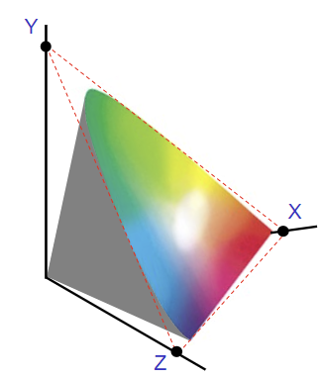
CIE Chromaticity Diagram

Slide 56
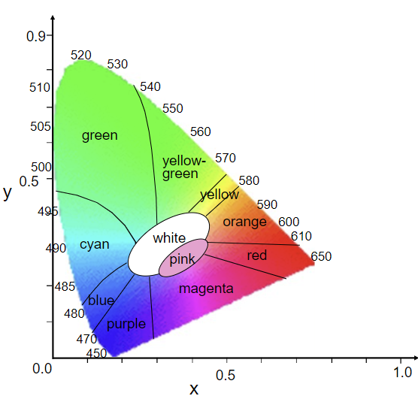
Color Naming

Slide 57
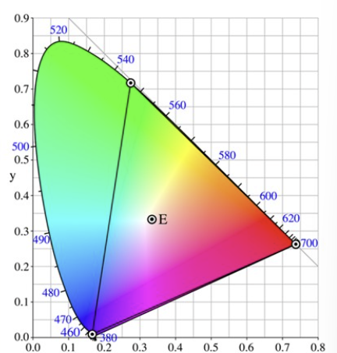
CIE-RGB Primaries

Slide 58
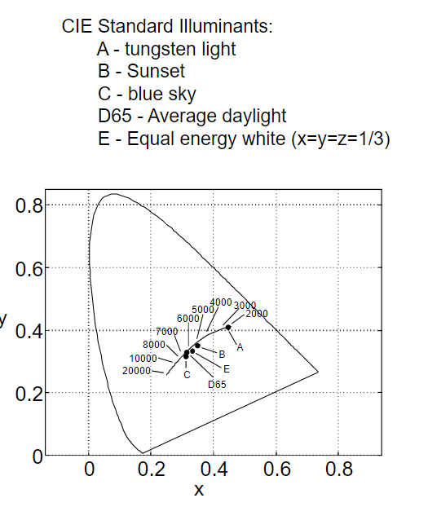
Blackbody Radiators and CIE standard Illuminants

Slide 59
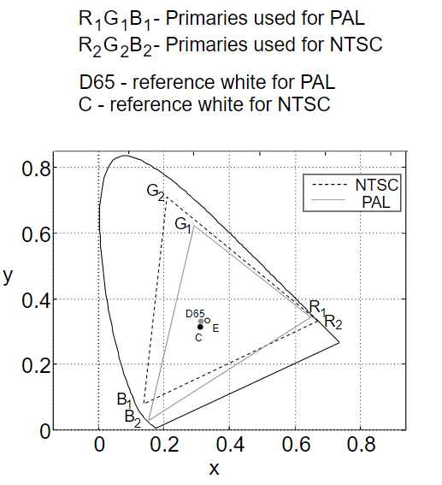
Television Primaries and Gamut
Phase Alternating Line (PAL)
National Television System Committee
Gamut is a certain complete subset of colors. The most common usage refers to the subset of colors which can be accurately represented in a given circumstance, such as within a given color space or by a certain output device
NTSC televisions broadcast 525 lines of resolution, while PAL televisions broadcast 625 lines of resolution.
Notes:
Gamut describes the range of color

Slide 60
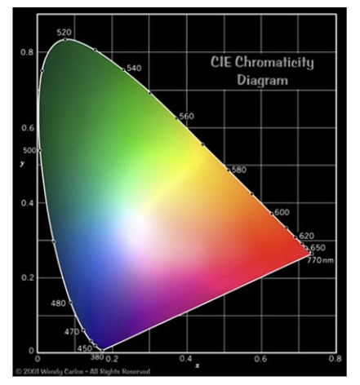
XYZ Color space Hue vs Saturation

Slide 61

Chromaticity in Polar Coordinates

Slide 62

Chromaticity in Polar Coordinates

Slide 63

Chromaticity in Polar Coordinates

Slide 64

Chromaticity in Polar Coordinates

Slide 65

Chromaticity in Polar Coordinates
Chromaticity is an objective specification of the quality of a color regardless of its luminance. Chromaticity consists of two independent parameters, often specified as hue (h) and colorfulness (s), where the latter is alternatively called saturation, chroma, intensity, or excitation purity.

Slide 66

Color description

Slide 67
Color stimuli
Color stimuli can be of different types as shown in Figure 9.4. When it has light of only one wavelength, it is called monochromatic, e.g. a laser beam. When the relative amount of light from all wavelengths is equal, then it is called achromatic. The sunlight is close to achromatic in the day time. Finally, if the stimulus has different amounts of light from different wavelengths, it is called polychromatic. Most of the time we deal with polychromatic light. Most of the man made and natural color stimuli are smooth spectra of polychromatic light.

Slide 68

Color stimuli

Slide 69

Reference
Textbook
Image processing

Slide 70

Question

Slide 71

Thank you

